Slide 1

Why Visualization?

Slide 2

Human perception
is powerful.
flickr cc 2.0
Star Gazing by uditha wickramanayaka
]
Notes:
As human we are quite good at making sense of the information around us visually.
One of the highest bandwidth cognitive channel we have vision and have 70% sense receptors located in our eyes.

Slide 3
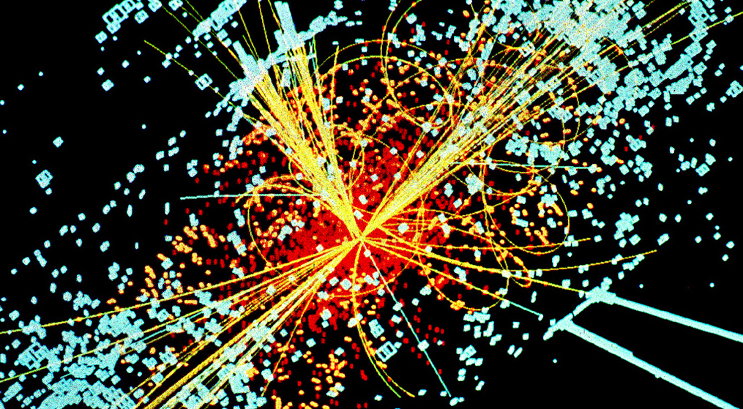
flickr cc 2.0
Big_Data_Higgs by KamiPhuc
Notes:
Data growing at an astounding rate, computational methods alone are not able to keep pace to explore, analyze and provide insights into all this data.
You likely already appreciate given the field you’re studying and the dataset you’ve already worked with in your careers in and in classes. There’s a lot there.
Photo: https://flic.kr/p/in4r4H

Slide 4
What is data visualization?
Notes:
So what is data vis and how can this help us?

Slide 5
Data visualization is the creation or study of systems of abstract visual encodings of data, designed to aid human insight.
Notes:
READ DEFINITION

Slide 6
Data visualization is the creation or study of systems of abstract visual encodings of data, designed to aid human insight.
Notes:
There is some abstraction of the data, it is represented visually in a form that is not the actual data. So a crowd scientist interpreting a photo of a crowd would not looing at abstract visual encodings, but if she turned encoded the people present with dots, or bubble shaped areas, now we’re talking, this would in fact be abstract visual encodings of data.

Slide 7
Data visualization is the creation or study of systems of abstract visual encodings of data, designed to aid human insight.
Notes:
Systems: how are these views represented. Increasingly this is done in ways supported by computers that allow for interactions and updated data in a way that is a bit different than ways presented by paper and pen, but we want to account for both so that’s what we mean by a system.

Slide 8
Data visualization is the creation or study of systems of abstract visual encodings of data, designed to aid human insight.
Notes:
Ways of visually encoding data aren’t good or bad on their own, but are dependent on the types of insights you’re trying to glean or provide.

Slide 9
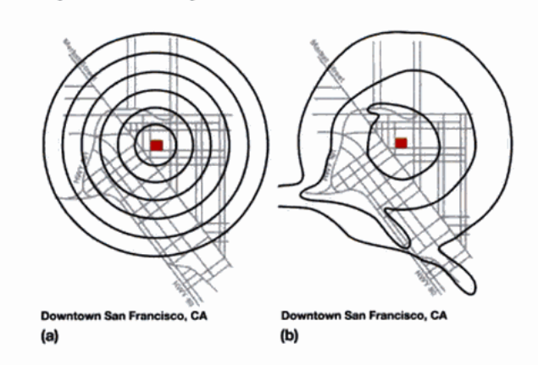
a)
b)
Source: Mackinlay, Card, & Shneiderman, 1999
Notes:
Here’s another example of how visualization, and more explicitly the proper encodings can drive actionable insights and allow us to offload some of our cognitive resources. Don’t worry, this one doesn’t involve guessing anything or talking to yourself. Here we have an map of downtown san francisco in the first, not too far from Berkeley, in a there are drawn isocost contours that show how far it takes to walk to various spots, as we might expect these radiate pretty equally around, in B there are iso cost contours that go farther and that there are freeways that in fact speed up this time in some areas. Based on this different abstract visual encoding of data we now know something about new.

Slide 10
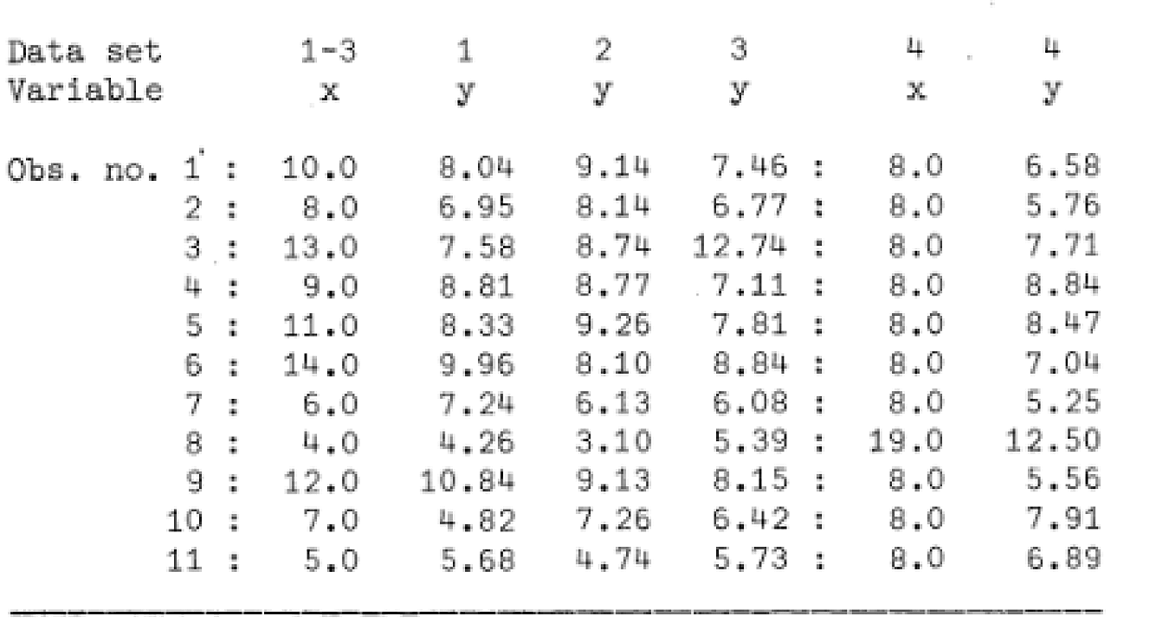
[Anscombe, 1973]
Notes:
Another common insight it finding patterns. Here we have the now classic example of Anscombe’s quartet. Francis Anscombe was an English statistician, so not actually a string instrument ensemble if that’s what you were hoping for, and he was a visualization proponent noting the importance of graphs. Here we have four datasets, and you can try to get a sense of them from the table of numbers alone

Slide 11
Mean of x | 9
Sample variance of x | 11
Mean of y | 7.50
Sample variance of y | 4.125
Correlation between x and y | 0.816
Linear regression line | y = 3 + 0.5x
[Anscombe, 1973]
Notes:
Here we have four datasets with nearly identical descriptive statistics. Pretty much the same means, same sample variance, same correlation values and linear regression lines within a few decimal places. The only issues was when you graph them …

Slide 12
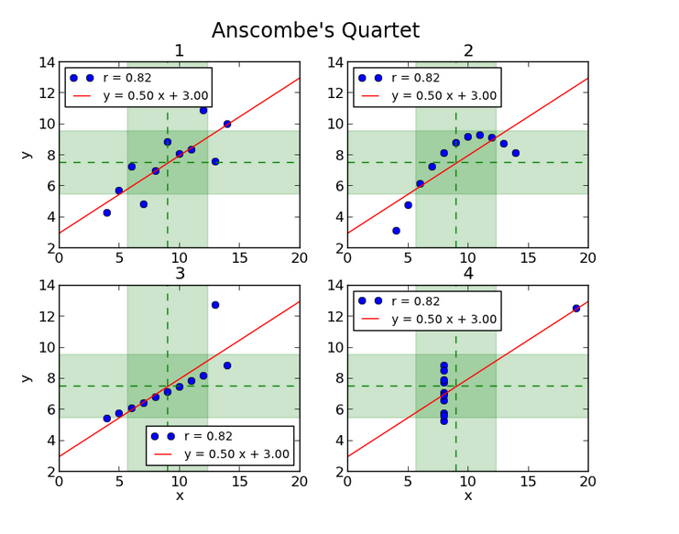
Source: http://informatique-python.readthedocs.io
Notes:
You can see that they look pretty different. Here we can detect very different patterns visually than we could by just looking at the data or by taking the descriptive statistics.

Slide 13
In Data Science
Derive value from data to provide actionable insights
Notes:
Visualization helps provide these insights at various points in the process

Slide 14

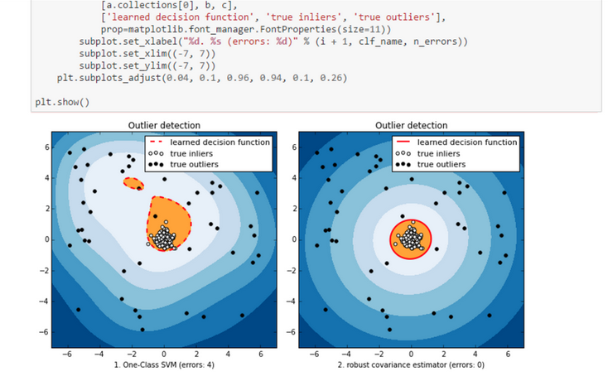
flickr cc 2.0
by Sebastian Sikora
Source: https://blogs.technet.microsoft.com
Notes:
, whether it’s to make decisions about the most appropriate algorithms to run, or show trends and patterns to other stakeholders or clients.
Example image for data science use.
Photo: https://flic.kr/p/dvgxhd

Slide 15


